Slide 1
Amazon Sales Data Analysis BY SHUBHAM PATHAK
Amazon is one of the leading E-commerce platform where users can buy millions of products from a lot of categories.

Slide 2
Objectives
To calculate total sales, total profit, average profit margin and average unit price
To find which order priority gave highest sales
To find which is the bestseller Item type
To find which mode of channel generated maximum sales
To find yearly total sales
To find total sales and total profit by region
To find the number of units sold of a particular item type

Slide 3
The Process
Data Collection
Data Cleaning
Data Analysis
Insights
Summary

Slide 4
Data Collection
The Data has been collected in the form of a CSV file named “Amazon Sales Data.csv”.
The CSV file has the data of sales of products during the timespan of 2010 and 2017.

Slide 5
Data Cleaning
There were no Null values or blank fields
Some values in ‘Order Date’ and ‘Ship Date’ columns are in String datatype. So we converted them to datetime datatype using Python
Most of the values in ‘Total Revenue’, ‘Total Cost’ and ‘Total Profit’ columns are written with two decimal places, so we make sure that each value in these columns have two decimal places by using Excel

Slide 6
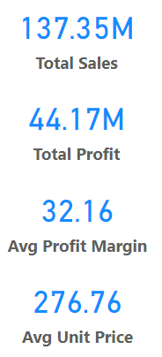
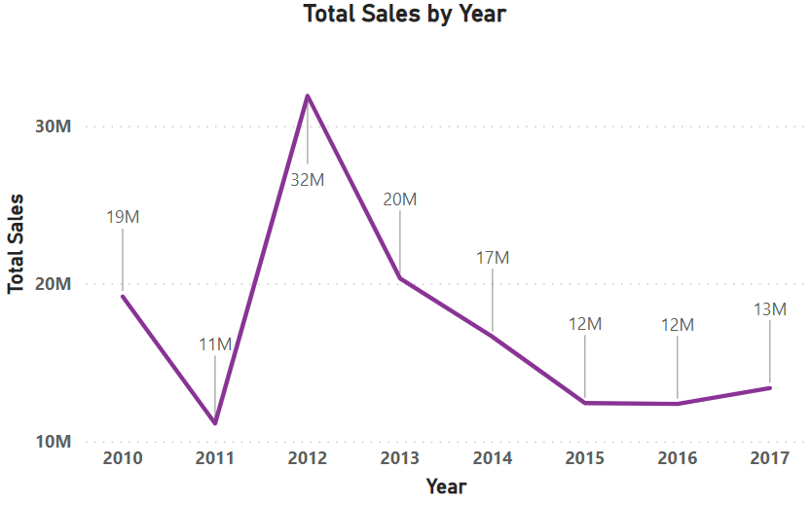
Data Analysis
Total Sales by Year

Slide 7
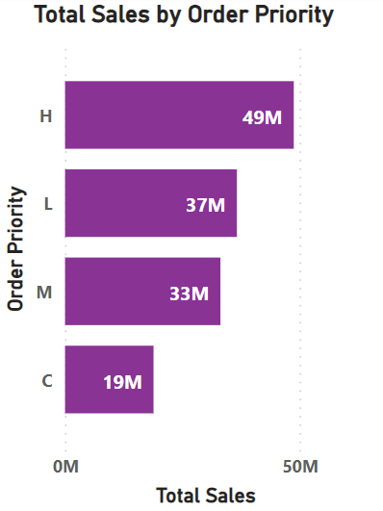
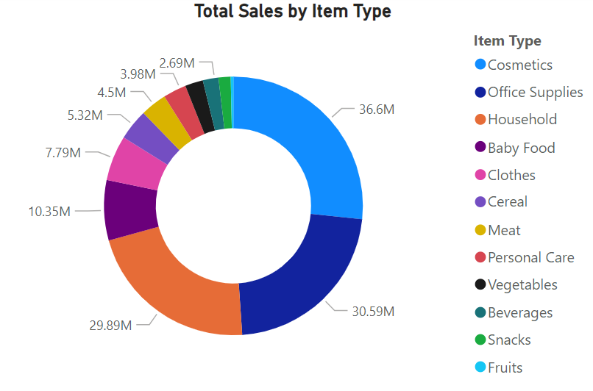






Data Analysis

Slide 8
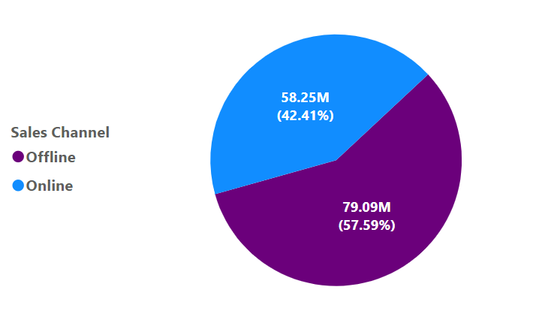
Data Analysis
Total Sales by Channel

Slide 9
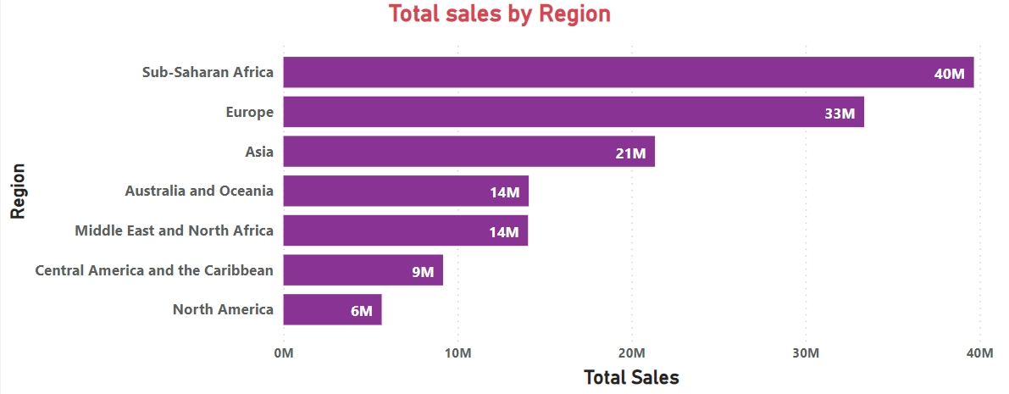
Data Analysis

Slide 10
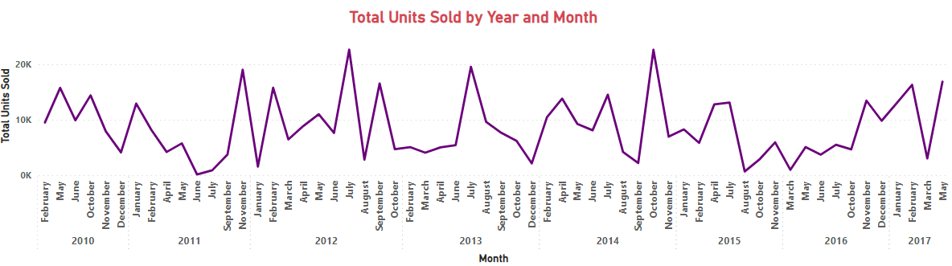
Data Analysis

Slide 11
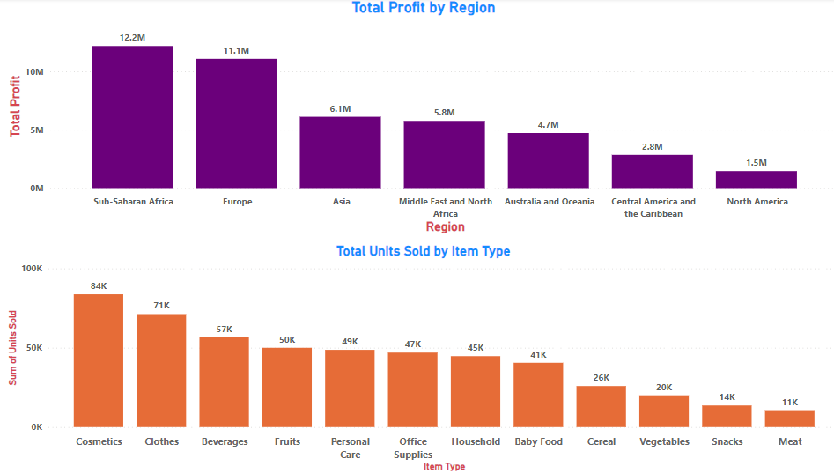
Data Analysis

Slide 12
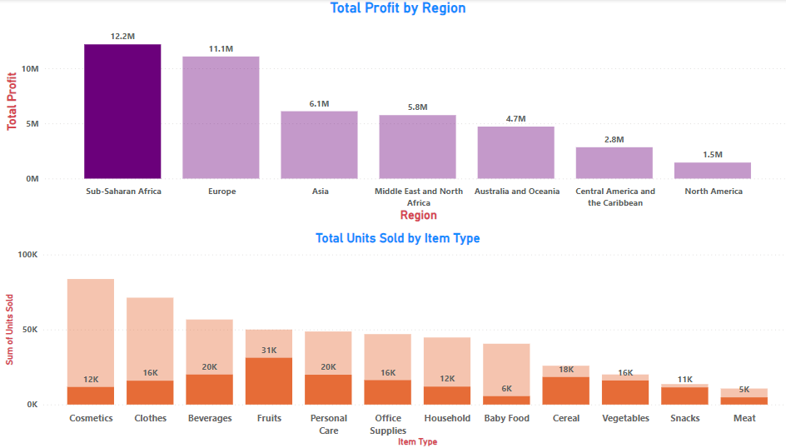
Data Analysis

Slide 13
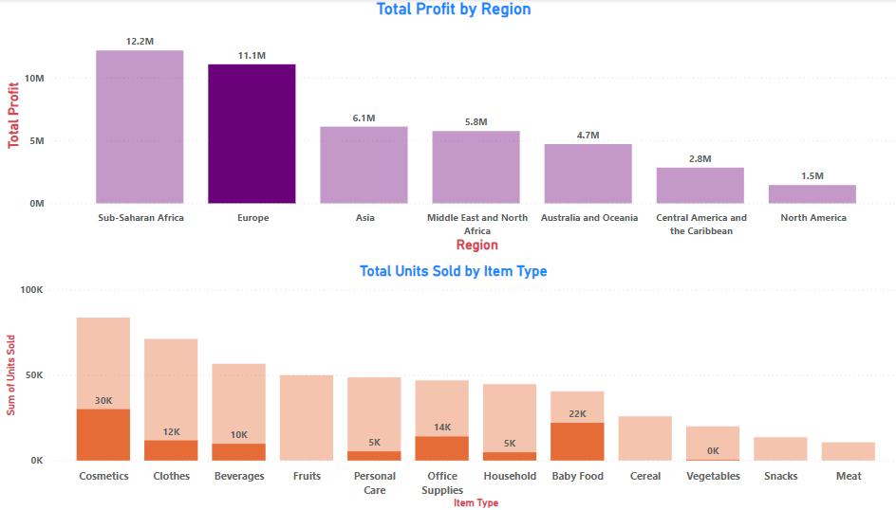
Data Analysis

Slide 14
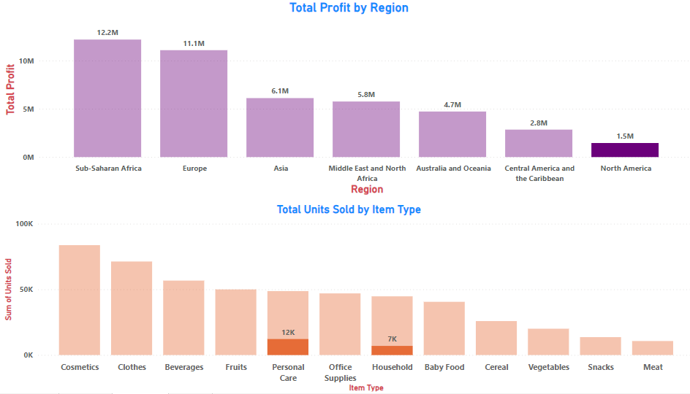
Data Analysis

Slide 15
Insights
The total sales is $137.35 million out of which total profit is $44.17 million.
The average profit margin and unit price is $32.16 and $276.76 respectively.
The “H” order priority gave the highest sales, which means people need their products fast.
“Cosmetics” products gave the highest sales.
Majority of people still prefer “Offline Channel” for buying products.
The year 2012 has seen the highest sales
The Sub-Saharan Africa region has seen the highest sales

Slide 16
Summary
Cosmetic products are very popular among people of Europe and these products generated the highest profit ($14.56 million) of all items. So, it is advisable to create some marketing campaigns promoting Cosmetic products.
Total Population of North America prefer to shop offline as compared to people of Europe, who mostly prefer Online channel for shopping. But because high profits are coming from Online channel, it advisable to promote products online.
The Region Sub-Saharan Africa has generated the highest profit where people bought Fruits the most, with approx. 31 thousands unit sold. Highlight the health benefits of fruits during campaigns and align marketing with local preferences.
The second most purchased item, after Cosmetics in Europe is Baby Food. This insight tells us that majority of people of Europe are newlywed couples. Thus you can promote products related to new born babies to these people.

Slide 17
Summary
Fruits has generated the least profit of all item types which is only $120.50 thousands. It is advisable to understand the customer needs, adjust the price and analyse the local preference.
North America Region has generated the least profit by selling only Personal Care and Household Items through Offline Channel. Try to promote products other than both these item types through Online Channel by giving some discounts. Do some survey to find local people’s preferences.
Meat is the least sold item type with 11 thousands units sold in Australia and Oceania and Sub-Saharan Africa Region using only Online Channel. Consider selling different kinds of meat products and adjust the prices.
Household Items and Cosmetic Products are sold the most through Offline and Online Channels respectively. Enhance physical stores with attractive displays and promotions for Household Items. Run targeted ads and make the website more user friendly for Cosmetic products.

Slide 18
Thank you

